Slide 1

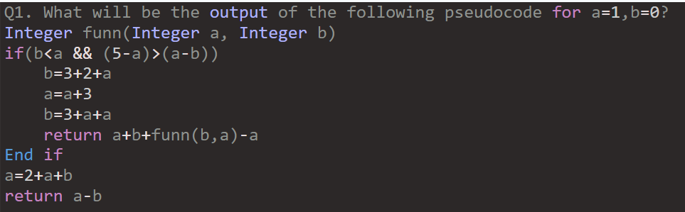
Accenture Actual Pseudo Codes & Solutions
32
28
21
24

Slide 2
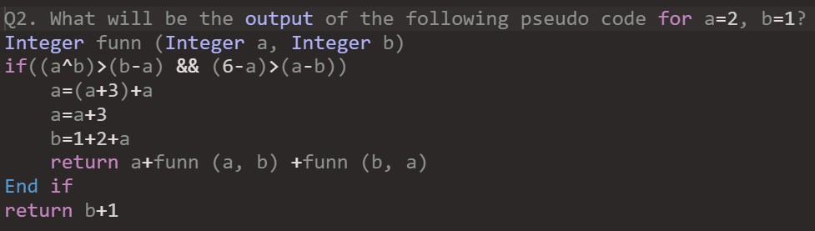
Accenture Actual Pseudo Codes & Solutions

Slide 3
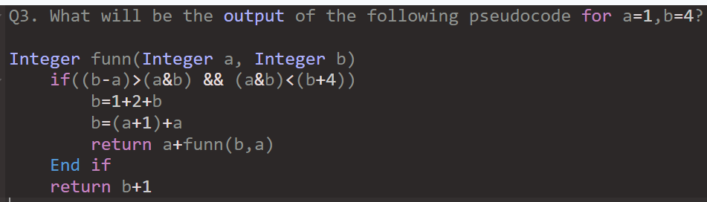
Accenture Actual Pseudo Codes & Solutions
4
21
-15
3

Slide 4
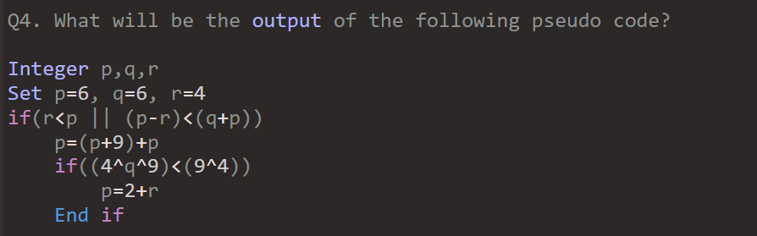
Accenture Actual Pseudo Codes & Solutions

Slide 5
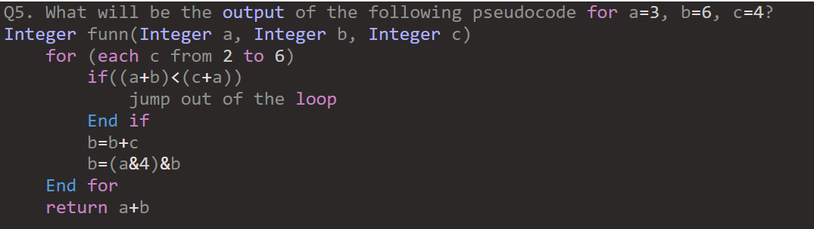
Accenture Actual Pseudo Codes & Solutions
10
13
0
3

Slide 6
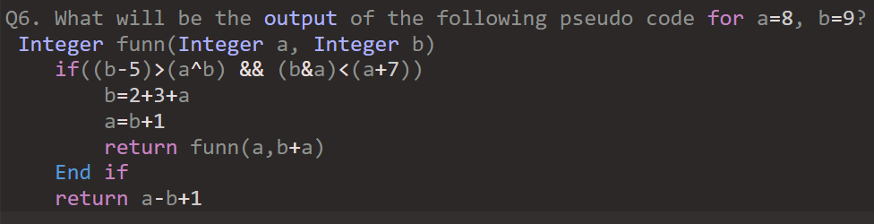
Accenture Actual Pseudo Codes & Solutions
-18
-17
-9
-20

Slide 7
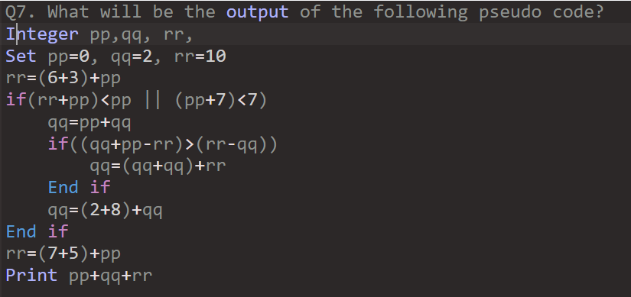
Accenture Actual Pseudo Codes & Solutions
23
18
10
14

Slide 8
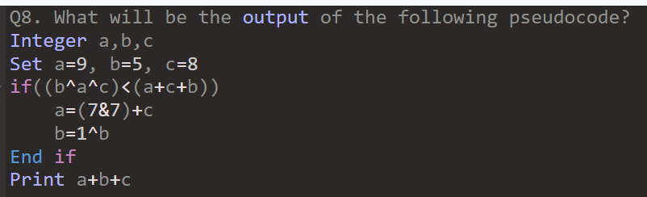
Accenture Actual Pseudo Codes & Solutions
46
35
13
27

Slide 9
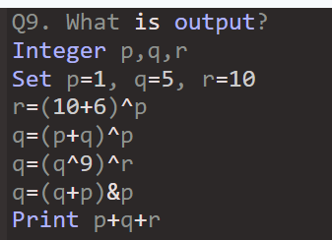
Accenture Actual Pseudo Codes & Solutions
18
27
21
14

Slide 10
Accenture Actual Pseudo Codes & Solutions
Q10. Predict the output of the following pseudocode for x = 10, y = 5.
Integer solve(Integer x, Integer y)
if(y > 0)
if(x > 0)
return x + y + solve(2, y - 5) + solve(x - 10, 1)
End if
End if
return x + y
End function solve()
15
18
13
17

Slide 11
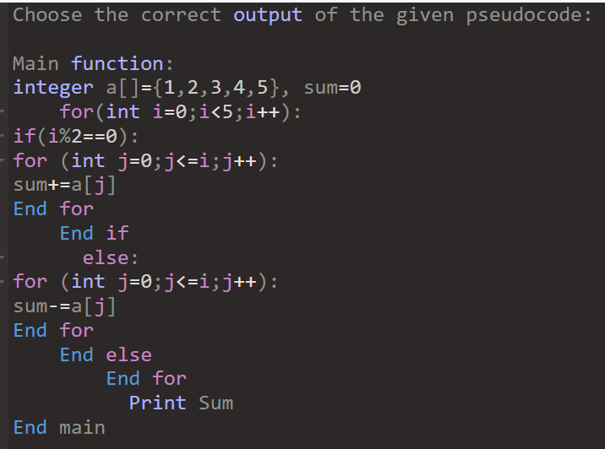
Accenture Actual Pseudo Codes & Solutions
Q11.
0.0
9.0
8.0
4.0

Slide 12
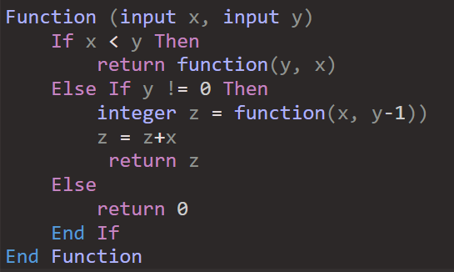
Accenture Actual Pseudo Codes & Solutions
Q12.
6
7
8
10

Slide 13
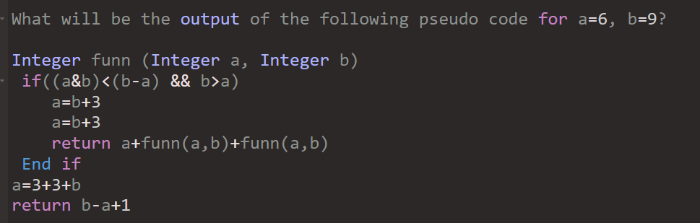
Accenture Actual Pseudo Codes & Solutions
Q13.
2
12
4
-3

Slide 14
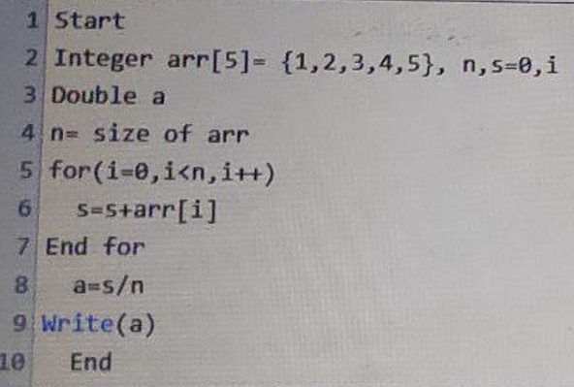
Accenture Actual Pseudo Codes & Solutions
Q14.
3.0
15.0
5.0
0.0

Slide 15
Accenture Actual Pseudo Codes & Solutions
Q15
Calculate the output of the following pseudocode.
Integer w, x, y, z
Set w = 1, x = 1
for (each y from 11 to 20 )
for (each z from -3 to 0 )
w = w + 5
if(w > y)
Continue
End if
w = 1
if(w > z)
Jump out of the loop
End if
End for
End for
Print w + x
2
3
22
8

